Slide 1





Cloud Native Application Development build fast, low TCO, scalable & agile software on Oracle Cloud
Oracle Groundbreakers APAC Virtual Tour 2021, 26th November
Lucas Jellema, CTO & Architect AMIS | Conclusion
Notes:
bit.ly/cloud-native-ogb-apacouc2021
TITLE
Cloud Native Application Development-build fast, low TCO, scalable & agile software on Oracle Cloud
DESCRIPTION
Cloud native applications offer scalability, flexibility, and optimal use of compute resources. Serverless functions interacting through events, leveraging cloud capabilities for persistent storage and automated operations take organization to the next level in IT. This session demonstrates polyglot Functions interacting with native cloud services for events and persistence (Object Storage and NoSQL Database) and leveraging the Key and Secrets Vault, Monitoring and Notifications services for operational control. A lightweight API Gateway is used to expose APIs to external consumers. Infrastructure as Code is the guiding principle in deploying both cloud resources and application components, through OCI CLI and Terraform. This session leverages many cloud native (enabling) services in Oracle Cloud Infrastructure. The session will introduce concepts, then spend most of the time on live demonstrations. All sources are shared with the audience, to allow participants to create the same application in their own cloud tenancy. What is so great about Cloud Native Applications? How do you create one? I will explain the first and demonstrate the second. On Oracle Cloud Infrastructure, using services that anyone can use for free, I will live create a cloud native application that streams, persists, notifies, scales, monitors Benefits: - get to know many different OCI services - understand the meaning, purpose and benefits of cloud native development - learn how to take your own first steps in OCI - for free!

Slide 2
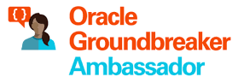



Lucas Jellema CTO for AMIS | Conclusion Cloud Solution Architect
lucas.jellema@amis.nl | technology.amis.nl | @lucasjellema | lucas-jellema

Slide 3

Castle on the Cloud – Physical Foundation

Slide 4


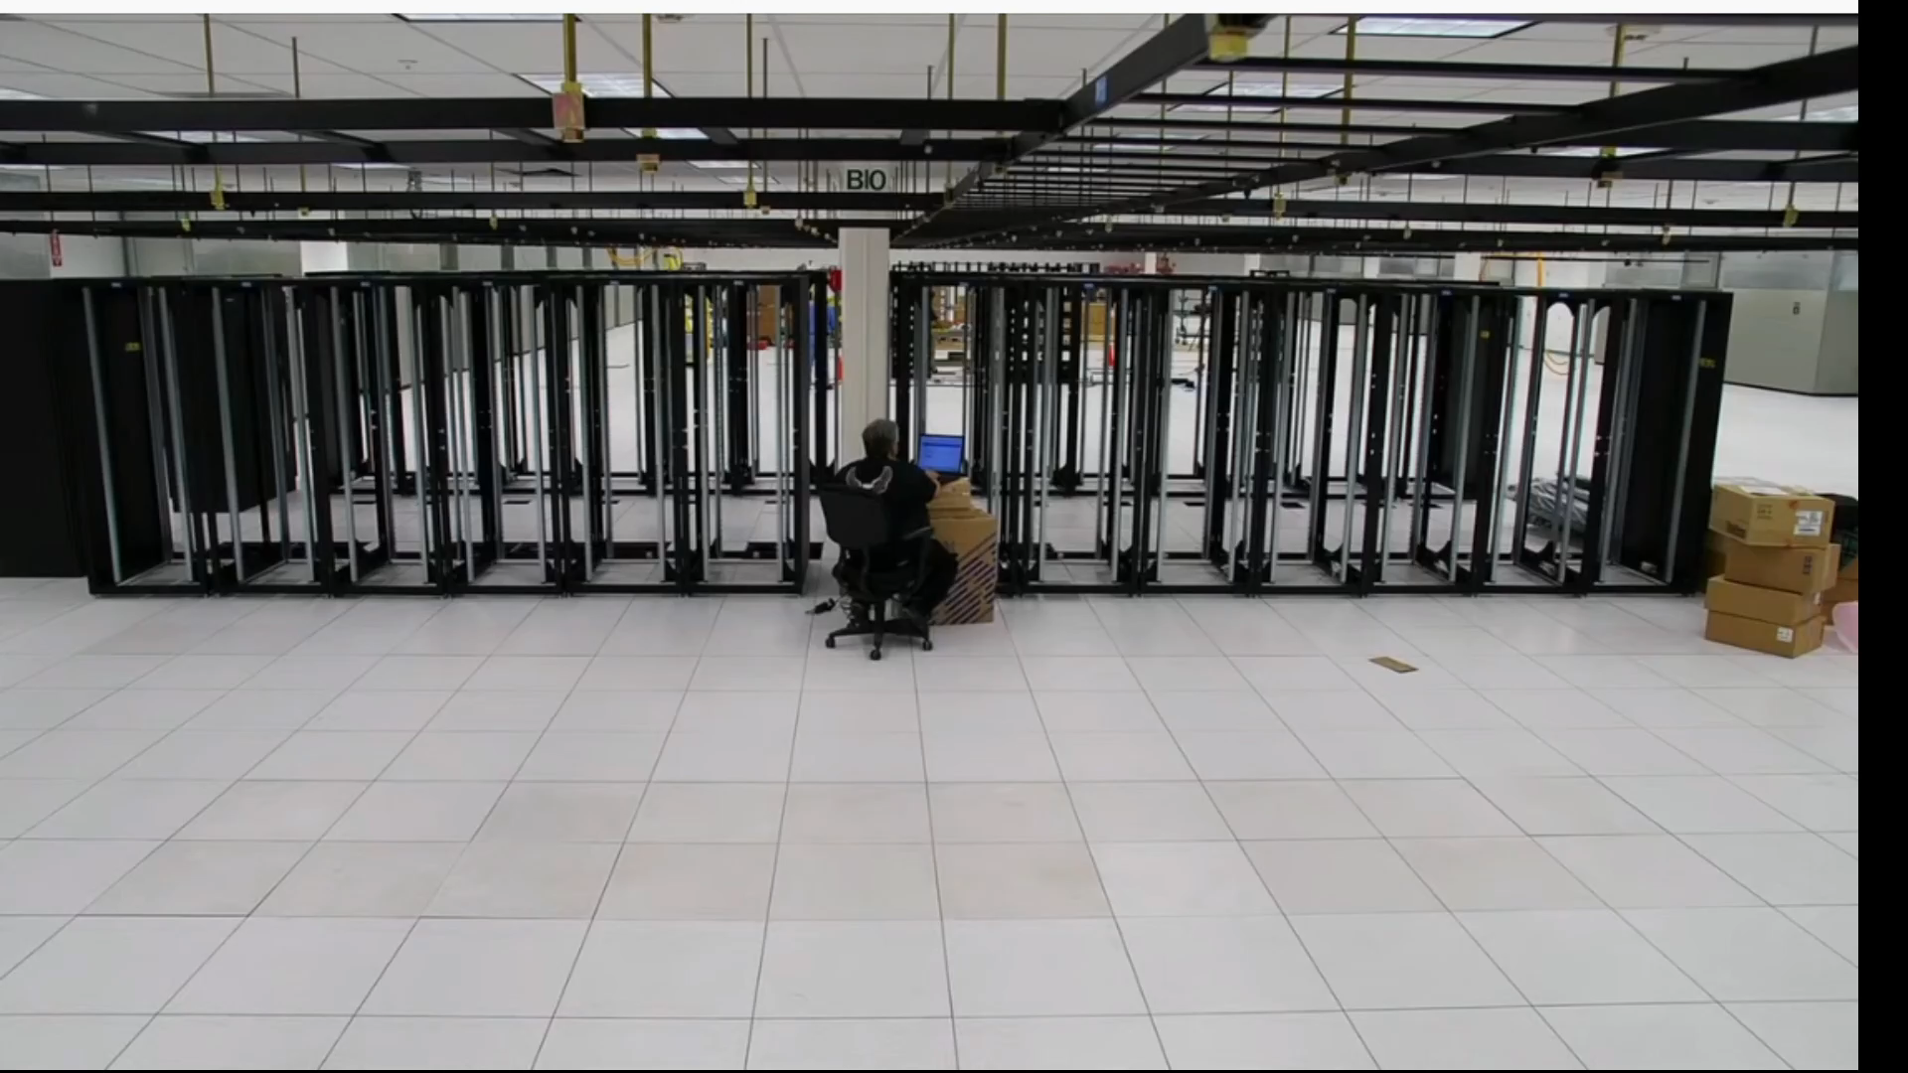


Castle on the Cloud – Physical Foundation
rackspace
power
cooling
real estate

Slide 5








Castle on the Cloud – Security Foundation
Security
digital & physical protection and monitoring
zones: Fault Domains, Availability Domains, Regions
offline, off-site archives
rack space
power
cooling
physical real estate

Slide 6

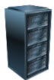






Castle on the Cloud – Infrastructure (real)
Servers
Storage
Network
Staff: acquisition, training, installation, monitoring, patching/upgrading/replacing
rack space
power
cooling
physical real estate

Slide 7
Castle on the Cloud – Cloud Facilities
Logging
Monitoring
Auditing
IAM
Vulnerability Scanning
Resource Manager
Cloud Usage Analysis
Cloud Events
APIs
Certificate Management
Notifications
Cloud Guard
Tagging
Search
rack space
power
cooling
physical real estate

Slide 8




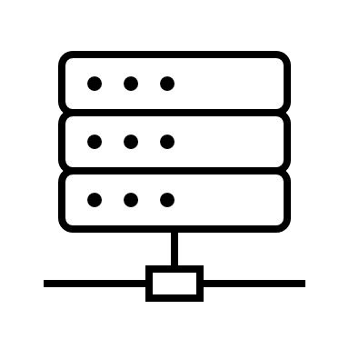
Castle on the Cloud – Infrastructure as a Service
Servers (VMs and bare, dedicated and shared, small ⬄ huge)
Storage (slow ⬄ fast, long⬄ short, object | block | ) & Encryption
Network (internal, private, external/public; VPN; cloud interconnect)
Logging
Monitoring
Auditing
IAM
Vulnerability Scanning
Resource Manager
Cloud Usage Analysis
Cloud Events
APIs
Certificate Management
Notifications
Cloud Guard
Tagging
Search
rack space
power
cooling
physical real estate

Slide 9
Castle on the Cloud – Platform as a Service
Blockchain
CDN
Conversational Services (chat)
AI Services
Web Application Firewall
BI & Analytics
API Gateway
Content Management
Low Code Applications
Data Catalog
Data Science & Big Data Engine
Container Registry
Load Balancer
Data Integration
Data Cache
Data Lake
Event Broker
Build & Deploy Pipelines
SQL Database
Job Scheduling
NoSQL Database
Serverless Functions
Container engine
Artifact Repository
Code Repository
Vault
Logging
Monitoring
Auditing
IAM
Vulnerability Scanning
Resource Manager
Cloud Usage Analysis
Cloud Events
APIs
Certificate Management
Notifications
Cloud Guard
Tagging
Search
rack space
power
cooling
physical real estate

Slide 10
Castle on the Cloud – Software & Data as a Service
ERP, CRM, SCM
Company Risk Analysis Data
Hospitality, Health, CPG, Discrete Processing, Education, …
IoT Device Management & Predictive Maintenance, Track & Trace, …
Self Service Analytics
DaaS for Sales
AI Services
Blockchain
Web Application Firewall
CDN
Conversational Services (chat)
BI & Analytics
API Gateway
Content Management
Low Code Applications
Data Catalog
Data Science & Big Data Engine
Container Registry
Load Balancer
Data Integration
Data Cache
Data Lake
Event Broker
SQL Database
Build & Deploy Pipelines
Job Scheduling
NoSQL Database
Serverless Functions
Container engine
Artifact Repository
Code Repository
Vault
Logging
Monitoring
Auditing
IAM
Vulnerability Scanning
Resource Manager
Cloud Usage Analysis
Certificate Management
Cloud Events
APIs
Notifications
rack space
Cloud Guard
Tagging
Search
power
cooling
physical real estate

Slide 11
Cloud Native Characteristics
Easy com, easy go: Instant (ready to use) & Disposable
Ephemeral
the only real state: Infrastructure as Code, Configuration & Business Data
Automated
Elastic Scalability
Pay for Used (or Configured/Reserved) Cloud Resources
Managed (operated and maintained)
Enterprise grade

Slide 12
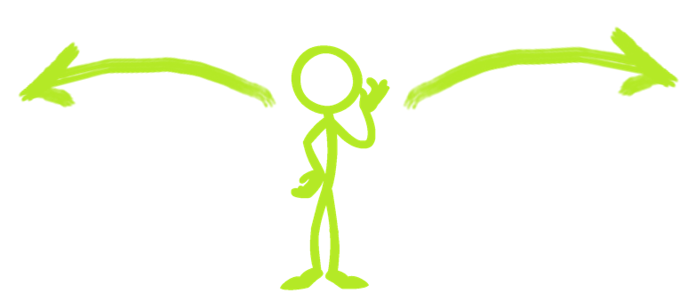
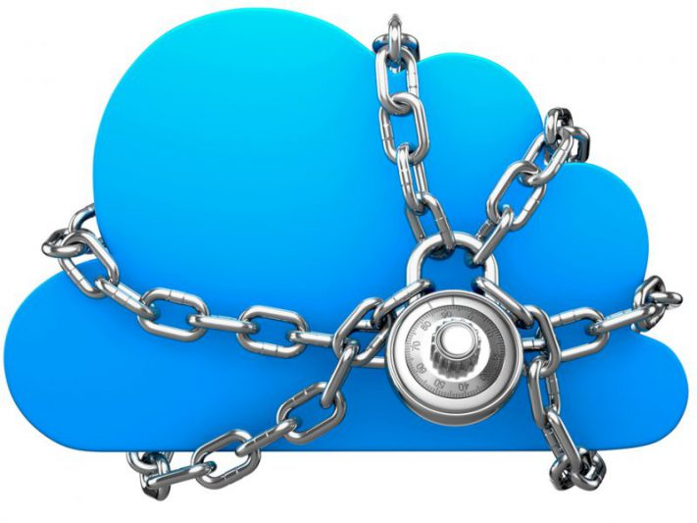
Cloud Native Custom Applications
All-in (SaaS > PaaS >>> IaaS)
Cloud Vendor Independent (IaaS++)
go all in with cloud vendor; leverage managed facilities and platforms to the max
minimize time spent on non-functional IT stuff
accept the vendor lock in
generic solutions that are vendor agnostic and stay decoupled from specific cloud platforms (as much as possible)
run on any cloud and on premises
typically using Kubernetes as platform for container-based components and applications
using open (source) technologies and products and associated staff & skills
accept the higher management effort on the platform components and more technical work (by more IT savvy staff)

Slide 13



Use Case: Selected Tweets to NoSQL, Streaming & Email
NoSQL Database
Streaming
#hashtagofinterest

Slide 14
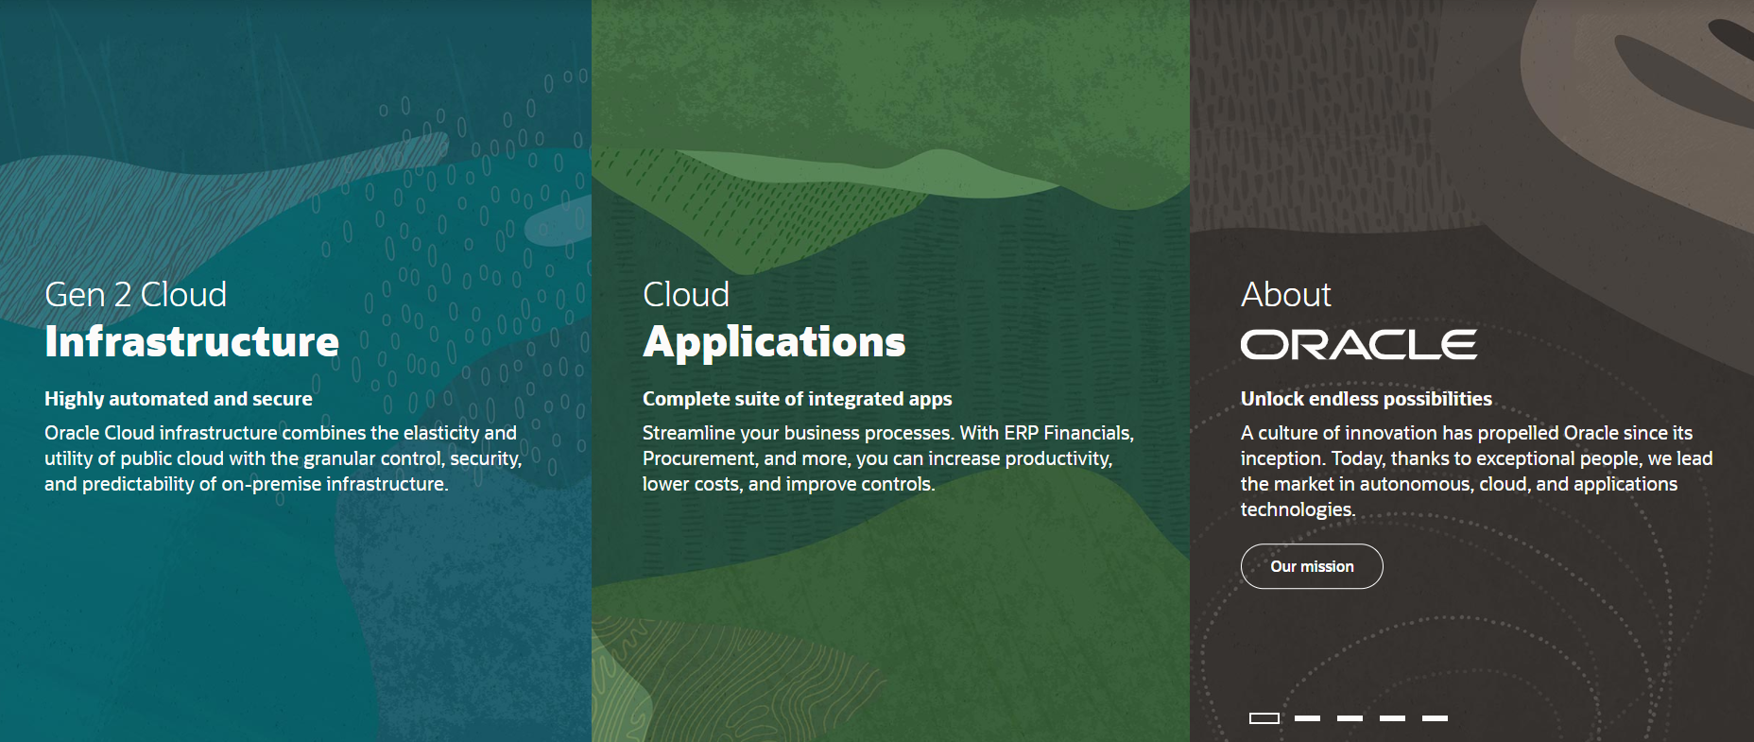
Introducing Oracle Cloud Infrastructure
IaaS & PaaS

Slide 15

Oracle Cloud Infrastructure
Generation 2 Cloud
built on lessons learned
Main themes:
Competitive Pricing
Secure by Design
Open
Enterprise (Technology)
Trials – 30 days, $300 credits
An always-free tier
With Autonomous Database and Autonomous Data Warehouse, Compute, Storage,
Many free tiers within paid services

Slide 16
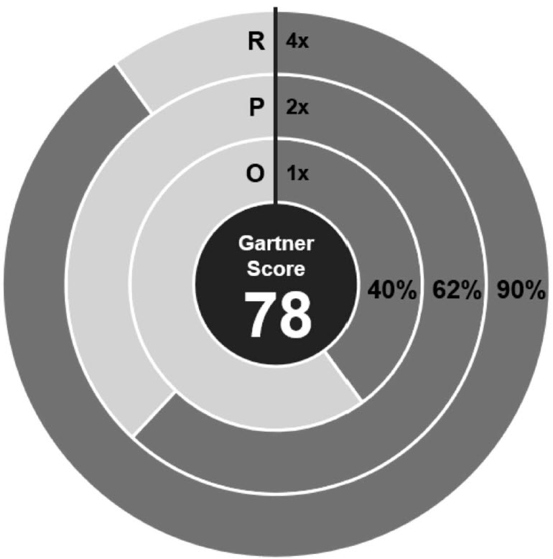
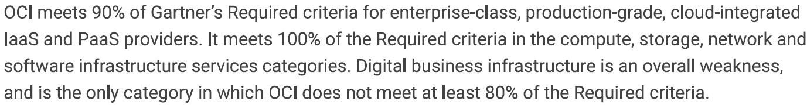
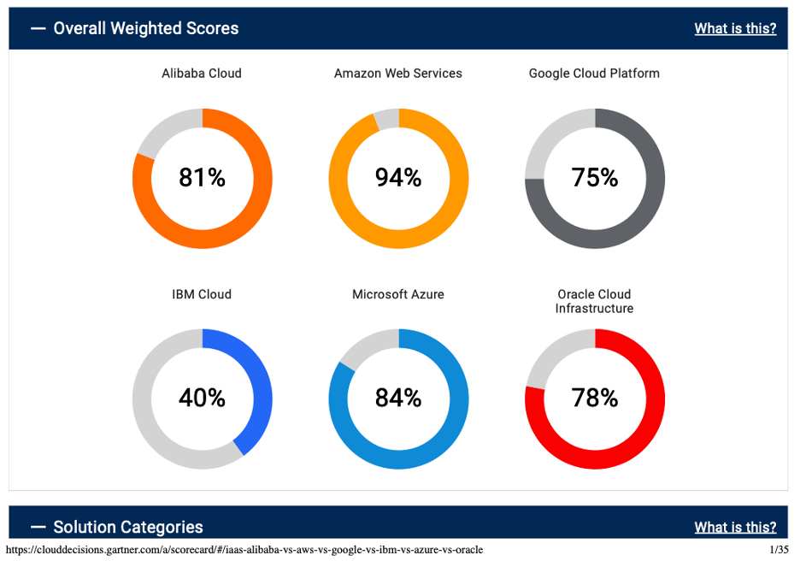
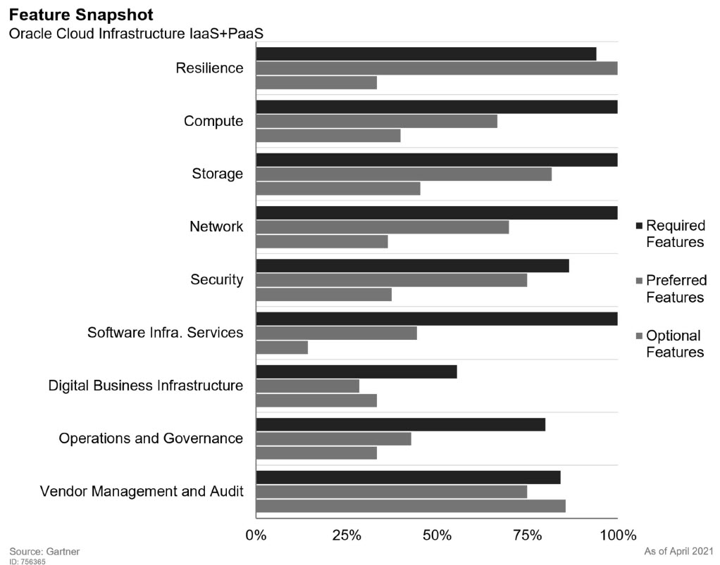
Gartner on OCI (September 2021)
Notes:
very cheap network egress
many services are very new
limited ecosysteem (partners and tools)
broad spectrum of bare metal/high performance
Oracle entered the public cloud laaS market in late 2015 with the Oracle Cloud Compute service. In October 2016, it launched a second-generation public cloud laaS service called Oracle Bare Metal Cloud Services (sometimes called the "Gen 2 Cloud"). One year later, it rebranded this second- generation offering as Oracle Cloud Infrastructure. The Oracle Cloud Compute offering was rebranded as Oracle Cloud Infrastructure Classic (and is outside the scope of this assessment).
OCI's engineering and product leadership have been recruited primarily from hyperscale cloud providers, and that experienced leadership has helped Oracle methodically expand OCI's capabilities to become an integrated laaS+PaaS provider. Oracle has also made several primarily security- focused acquisitions to accelerate this development, including Dyn and Palerra, in 2016, and Zenedge in 2018. OCI has reached the point where its basic foundations are complete, and the velocity of service launches continues to increase.
For the second year in a row, OCI's solution score has improved markedly since the prior year’s assessment, due to both the introduction of major new services as well as incremental additions of important features to existing services. These new additions reflect thoughtful prioritization of capabilities important to enterprise customers. While the services themselves rarely represent innovative ideas, individual new features demonstrate increased competitive differentiation. (See Note 1 for other assessment details.)

Slide 17
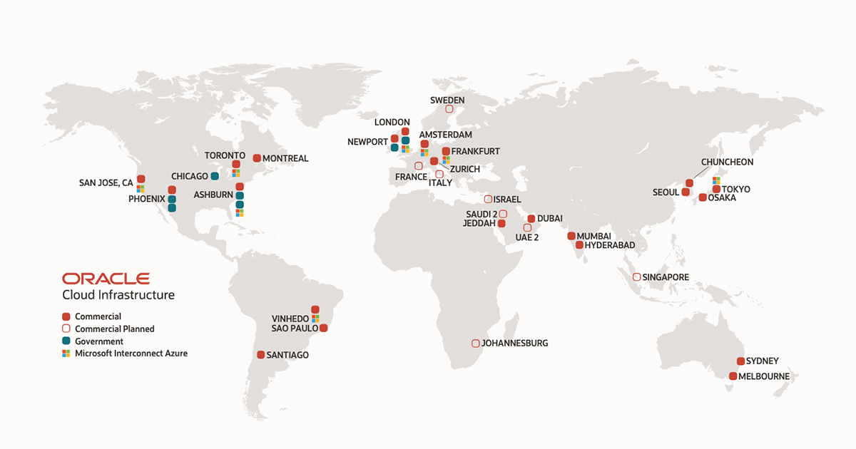

OCI Physical Organization
Regions have one or more Availability Domains
An AD lives in one or more Data Centers
ADs are isolated from each other – unlikely to fail together
ADs within a region have very fast, ultra-low latency interconnecting network backbone
Fault domains are isolated hardware clusters
With exclusive patch schedule
Each AD has three fault domains
Fault Domain
Data Center
Availability Domain
Region

Slide 18
Oracle Cloud Infrastructure Regions – current and planned

Slide 19





Demonstration of Cloud Native Application on OCI: Tweets to NoSQL, Streaming & Email
Function
Object Storage
Function
Events
Notifications
NoSQL Database
API Gateway
Healthcheck
Streaming
#hashtagofinterest

Slide 20






Cloud Native design Tweets to NoSQL, Streaming & Email
Store JSON file with all tweets in time period
Cloud Event for new JSON file
Create Tweet Records in NoSQL
Trigger function with event
Invoke Tweet Aggregator every X minutes
NoSQL Database
Function
Publish to Notification Topic
Expose function to external callers
Object Storage
Healthcheck
Write JSON document with Tweets
Custom code in multiple small units that each build | test | deploy | scale | fail
Asynchronous interactions
Managed Platform (and underlying Infra) with built in logging | monitoring | Ops Configured through Infra as Code
API Gateway
Streaming
Events
Publish each Tweet to Stream
Function
Retrieve X minutes worth of tweets
Notifications
Send Tweet Report as email
Get Twitter credentials in secure way from vault
Vault
Logging
Container Registry
Monitoring
#hashtagofinterest
Auditing

Slide 21

Decoupling
Encapsulation (of implementation)
Run time availability independence
Independent release / reconfigure
Independence of scaling
Volume Load Throttling/Absorption
Security Boundary
Failure isolation
NoSQL Database
Function
Object Storage
API Gateway
Streaming
Events
Function
Notification Topic
Vault
Logging
Container Registry
Monitoring
#hashtagofinterest
Auditing

Slide 22


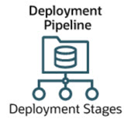
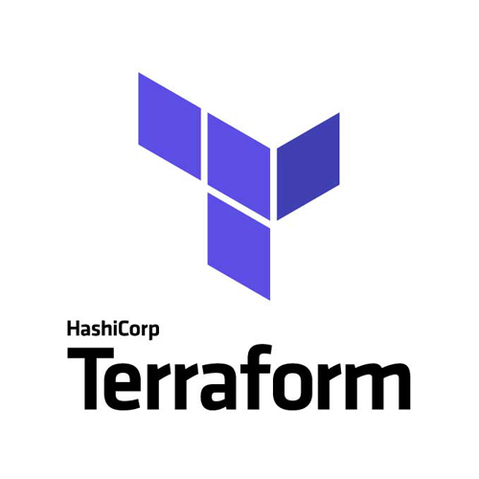
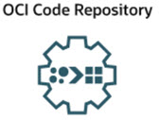
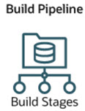
Platform Preparation – Infrastructure as Code using Resource Manager & Terraform plan
Function
Events
Notifications
Virtual Cloud Network with private and public subnet and access from and to public internet
Object Storage Bucket
API Gateway
NoSQL Database Table for persisting records
Healthcheck
Object Storage
Stream for publishing messages to
Skeleton API Gateway for deploying API routing rules to
Route Table
API Gateway
Internet Gateway
Security Lists
Dynamic Groups for API Gateway and for Functions
Virtual Cloud
Network
Streaming
Configuration of Logging Service for Functions
Compartment for Application resources
Notification Topic
Groups
Notification Topic for new Tweet Report events
Secure Vault with Keys for Twitter credentials
Compartments
Container Registry
Vault
DevOps
Auditing
Logging
Resource
Manager

Slide 23

Building my castle on the cloud
Create Tenancy (OCI Cloud Account) & Compartment
setting up imaginary rackspace for virtual servers and storage
Logging
Telemetry/ Monitoring
Resource
Manager
Auditing
Compartments
Identity & Access
Management

Slide 24
Building my castle on the cloud
Create Tenancy (OCI Cloud Account) & Compartment
setting up imaginary rackspace for virtual servers and storage
VCN Wizard for virtual network
create connections internally
Route Table
Security Lists
Internet Gateway
Virtual Cloud
Network
Logging
Telemetry/ Monitoring
Resource
Manager
Auditing
Compartments
Identity & Access
Management

Slide 25
Building my castle on the cloud
Create Tenancy (OCI Cloud Account) & Compartment
setting up imaginary rackspace for virtual servers and storage
VCN Wizard for virtual network
create connections internally
Platform components (terraforming on the cloud through Infrastructure as Code)
instead of setting up servers, cables, OS images, configuring networks, software installation & configuration
Everything ephemeral – except the data, configuration and code
At this point: no custom functionality yet
Object Storage
NoSQL
API Gateway
Route Table
Security Lists
Internet Gateway
Streaming
Virtual Cloud
Network
Container Registry
Notification Topic
Vault
Groups
Logging
Telemetry/ Monitoring
Resource
Manager
Auditing
Compartments
Identity & Access
Management

Slide 26
The custom functionality for this use case?
High coding in serverless functions
read from Twitter, persist to file
process tweets-file, publish to database and event stream
API Gateway
route to function TweetRetriever
Cloud event rule
push event to notification topic
Notification subscription
invoke function
publish email
And functional configuration
twitter credentials
email address to send notification to
Using DevOps Build and Deploy Pipelines for automated rollout
Function
Object Storage
NoSQL
API Gateway
Events
Function
Streaming
Notification Topic
Vault
DevOps
Container Registry

Slide 27

Serverless Functions are the Workhorse of OCI for non-long-running tasks

Slide 28
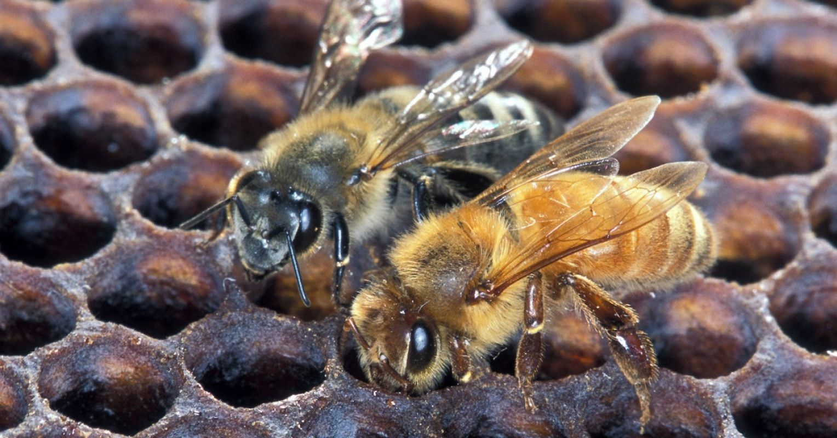
Serverless Functions are the Worker Bees of OCI

Slide 29


Serverless Functions on OCI
OCI Serverless Functions are based on Fn
Project Fn is an open source FaaS platform that [in theory] you can run anywhere – any cloud, on-premises or locally.
A function handles an HTTP Request
Functions are implemented with custom code and packaged in [Docker] container images
Out of the box support for many runtimes
also support for custom Docker Container (white box)

Slide 30

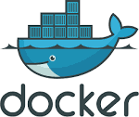
Fn Functions – request handling
With method, headers, query parameters, url path, body
Function as a Service framework
FDK
HTTP Request
Function Implementation (Node, Java, Go, Python, custom Docker, …)
input – derived from body
ctx – raw HTTP request components

Slide 31

OCI Functions
OCI DevOps
Stateless
Load balanced
Routed
Authorization enforced
Short running tasks
Configuration parameters
Rapid startup
Pay per GB minute
HTTP Request
OCI Functions
API Gateway
HTTP Request
Application
Function
Logging
Monitoring
Auditing

Slide 32
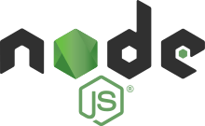

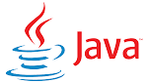
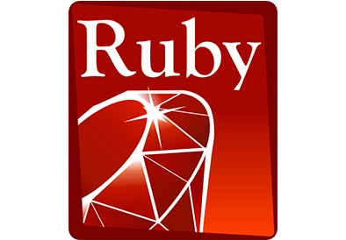

Mental Picture: Stateless and Serverless
FDK

Slide 33

Mental Picture: Stateless and Serverless “execution engine”
Configuration Parameters
FDK

Slide 34

Mental Picture: Build Process
Container Image Registry
FDK
push
FDK
Operating System
Language Runtime
go1.15, java8, java, java11, node, node14, python, python3.6, python, python3.7, python3.8, ruby, and kotlin
Notes:
Additional settings: max time to run (<= 120 seconds)
Note: size of local file system is related to memory shape (32, 64, 128, 256MB) as is the number of files

Slide 35
Mental Picture: Build & Deploy Process
Container Image Registry
Deploy Function Application
Associated with Network & Compartment
Specify max time to run and memory shape (128, 256, 512, 1024 MB) for function
FDK
push
Oracle Functions on OCI
FDK
Operating System
Language Runtime
Notes:
Additional settings: max time to run (<= 120 seconds)
Note: size of local file system is related to memory shape (32, 64, 128, 256MB) as is the number of files

Slide 36
Mental Picture and Actual Runtime
128 | 256 | 512 | 1024 MB Memory, 32 | 64 | 128 | 256 MB File System
File system can be read, /tmp can be written to
Configuration Parameters available as Environment Variables
Container Image Registry
Oracle Functions on OCI
Container Orchestrator
Serverless
Memory Shape, Max Time to Run, Configuration Parameters
VM
Server
Notes:
Additional settings: max time to run (<= 120 seconds)
Note: size of local file system is related to memory shape (32, 64, 128, 256MB) as is the number of files

Slide 37
Mental Picture and Actual Runtime
Container is kept running for 10-15 minutes – primed (hot) for handling more requests.Then it is removed when it has been idle for that time.
It retains global state and file system contents during its lifetime. Note: hold on to and reuse expensive connections. Container handles one request at a time. Container can perform 10-13 seconds of background work after response was returned.
Container Image Registry
Oracle Functions on OCI
Container Orchestrator
Stateless
VM
Server
Logging
Monitoring
Auditing
Notes:
Additional settings: max time to run (<= 120 seconds)
Note: size of local file system is related to memory shape (32, 64, 128, 256MB) as is the number of files

Slide 38
Mental Picture and Actual Runtime
Container Image Registry
Oracle Functions on OCI
Container Orchestrator
VM
Server
Logging
Monitoring
Auditing
Notes:
Additional settings: max time to run (<= 120 seconds)
Note: size of local file system is related to memory shape (32, 64, 128, 256MB) as is the number of files

Slide 39
Mental Picture and Actual Runtime
Container Image Registry
Oracle Functions on OCI
Container Orchestrator
VM
Server
Logging
Monitoring
Auditing
Notes:
Additional settings: max time to run (<= 120 seconds)
Note: size of local file system is related to memory shape (32, 64, 128, 256MB) as is the number of files

Slide 40
Mental Picture and Actual Runtime
Oracle Functions starts multiple Docker containers, up to the limit specified for your tenancy. The default limit is 30 GB of RAM reserved for function execution per availability domain
Container Image Registry
Container Orchestrator
VM B
Server 2
Oracle Functions on OCI
Container Orchestrator
VM A
Server 1
Logging
Monitoring
Auditing
Notes:
Additional settings: max time to run (<= 120 seconds)
Note: size of local file system is related to memory shape (32, 64, 128, 256MB) as is the number of files

Slide 41
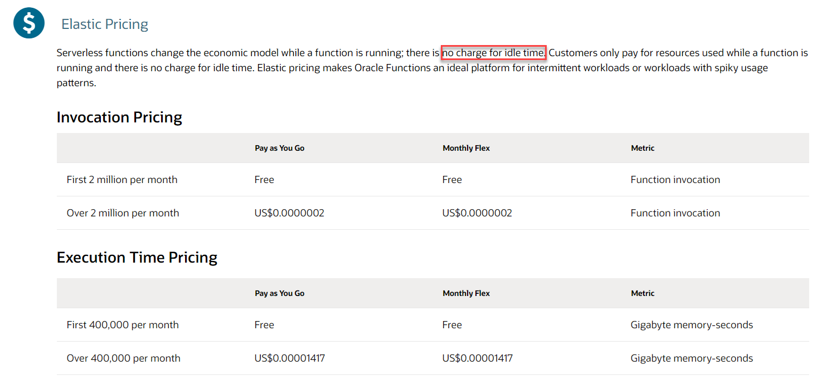
Pricing Oracle Functions – no use, no pay (and even if quite a bit of use – then still no pay)

Slide 42


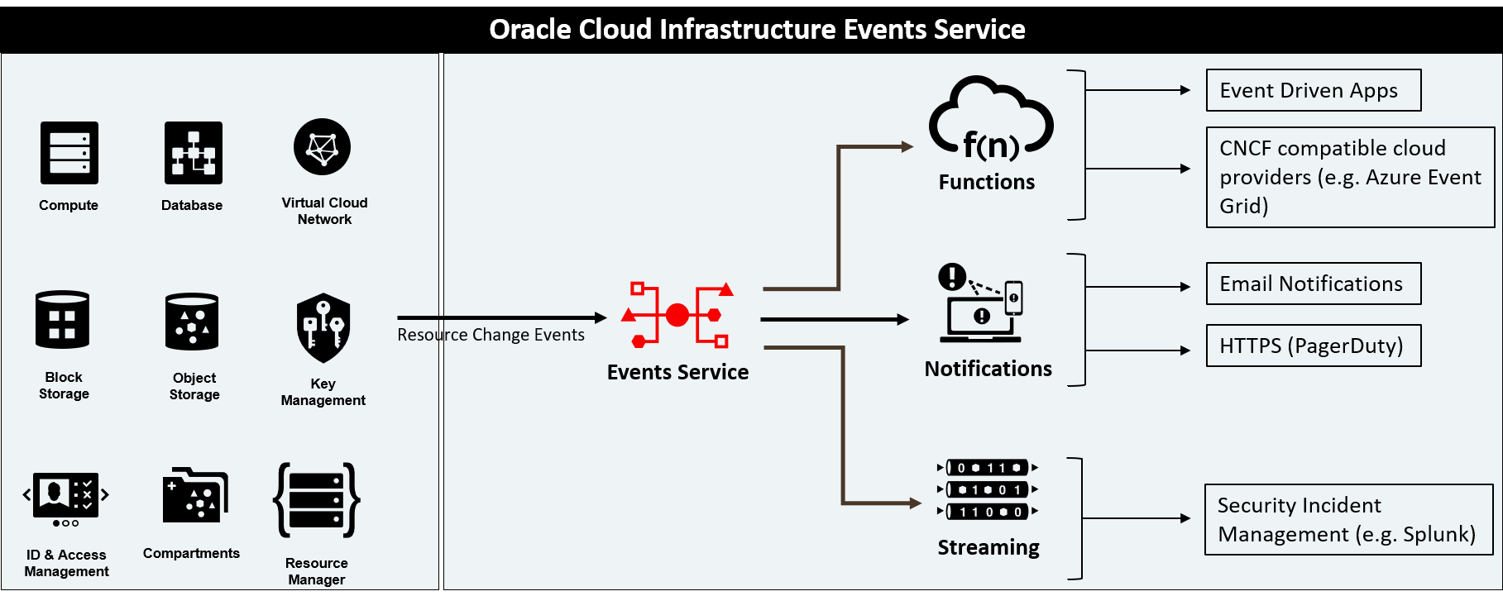



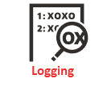

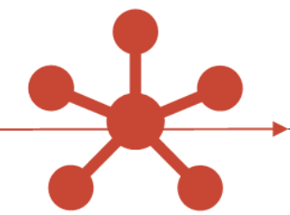

Function execution is triggered by
Any HTTP request
Authenticated, Signed HTTP request
API Gateway
Healthcheck
Functions
Events
Notifications
Alarming
Resource
Manager
Service Connector
OCI DevOps
Streaming

Slide 43
Function execution is triggered by
Ops automation
App
Any HTTP request
Authenticated, Signed HTTP request
Application
App
Ops
API Gateway
Healthcheck
Ops
Functions
Events
App
Ops
Ops
Notifications
Ops
Alarming
Alarming
Ops
Ops
Resource
Manager
Service Connector
OCI DevOps
Streaming

Slide 44




Leverage OCI PaaS Services and Facilities from Functions
Streaming
synchronous
NoSQL Database
API Gateway
Object Storage
Functions
asynchronous
Autonomous Database
Notifications
Email Delivery
Autonomous JSON
Logging
Monitoring
Auditing
Vault

Slide 45
Allow Functions to Invoke OCI APIs through Resource Principal authorization
Any OCI API call must be authenticated (signed) and authorized
(Human) users can be granted permissions and can sign requests
A function can be a resource principal – that is granted permissions (via Dynamic Group) and gets an auto-generated key-file injected used for signing
Function
Object Storage

Slide 46
Allow Functions to Invoke OCI APIs through Resource Principal authorization
Any OCI API call must be authenticated (signed) and authorized
(Human) users can be granted permissions and can sign requests
A function can be a resource principal – that is granted permissions (via Dynamic Group) and gets an auto-generated key-file injected used for signing
Policy
Resource
pem
rpst
Function
Dynamic group
Object Storage
Rule

Slide 47
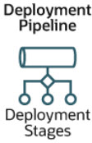
Application as code
Functions are NodeJS applications
develop and test (run) as standalone applications
Built from Code Repository as Fn Container Images in OCI DevOps build pipeline
pushed to Container Image Registry
Deployed from Registry in OCI DevOps deployment pipeline to Function Application on OCI
Manually create secret in vault with Twitter credentials
Pass secret’s identifier as function configuration
Git Code Repository
Build Pipeline
Container Registry

Slide 48

Serverless Function & Object Storage
Function
Events
Notifications
Store JSON file with all tweets in time period
API Gateway
Object Storage
Healthcheck
Write JSON document with Tweets
Git Code Repository
Retrieve X minutes worth of tweets
Function
Tweet Summarizer
Function
Build Pipeline
Central Logging Service
Get Twitter credentials in secure way from vault
Vault
Logging
Container Registry
Auditing
Container Image Registry
#hashtagofinterest

Slide 49
Trigger
Function
Events
Notifications
Object Storage
Healthcheck
Expose function to external callers
API Gateway
Function
Tweet Summarizer
Function
Vault
#hashtagofinterest

Slide 50
[how to] Trigger Email Notification
Function
Events
Notifications
Object Storage
?
Healthcheck
Expose function to external callers
API Gateway
Function
Tweet Summarizer
Function
Send Tweet Report as email
Vault
#hashtagofinterest

Slide 51
Produce CloudEvent & Publish Notification
Function
Cloud Event for new JSON file
Publish to Notification Topic
Object Storage
Healthcheck
API Gateway
Events
Notifications
Function
Send Tweet Report as email
Vault
#hashtagofinterest

Slide 52
EVENTS and NOTIFICATIONS SERVICES

Slide 53
Events identified and turned to Notification Events to be Published and Routed
Pager Duty
Slack
Functions
Alarming
Web Hook
Event
OCI Resource
Cloud Event
Event
Email
Cloud Event
Notifications
Event
Event Rules
Notification
Topic
Functions
Subscriptions
Event
Streaming
Functions
Streaming

Slide 54
THE BASICS FOR THESE TWO SERVICES ARE…
EVENTS SERVICES
NOTIFICATION SERVICES
Event
OCI Resource
Cloud Event
Event
Email
Notifications
Event
Event Rules
Notification
Topic
Functions
Event
Streaming

Slide 55
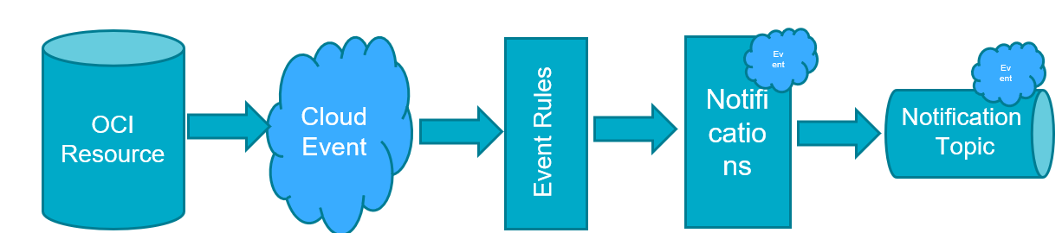
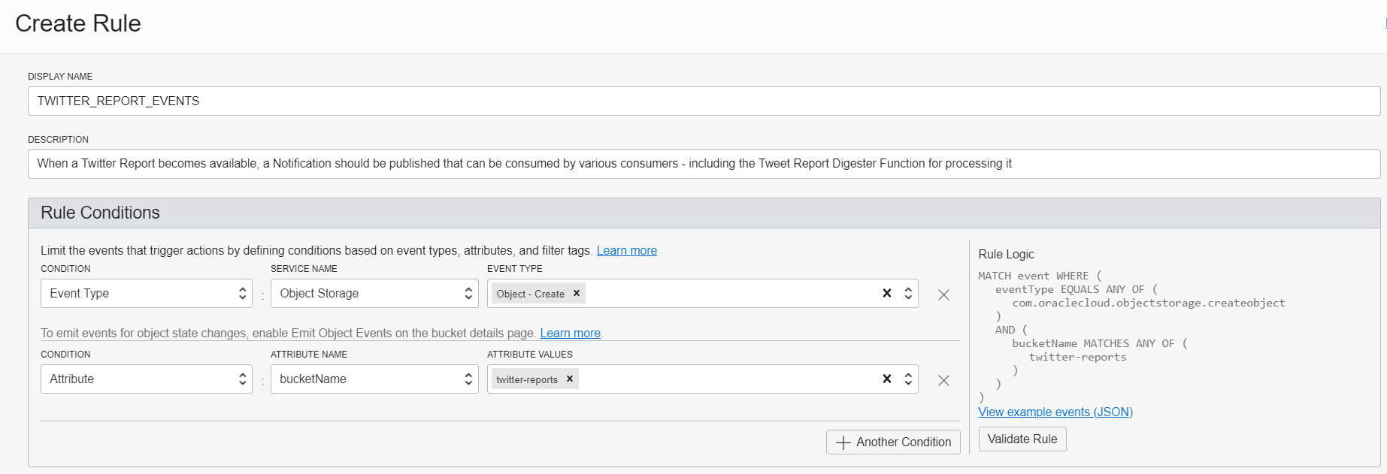
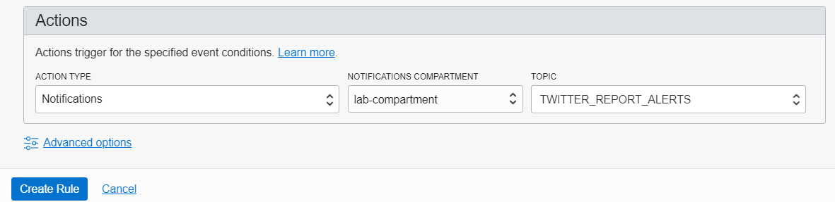
Configure Event Rule Notification triplet
Cloud Event
Event Rules
OCI Resource
Notifications
Notification
Topic

Slide 56
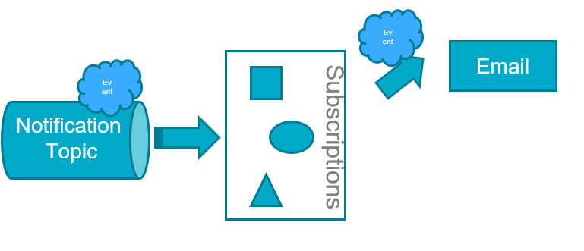
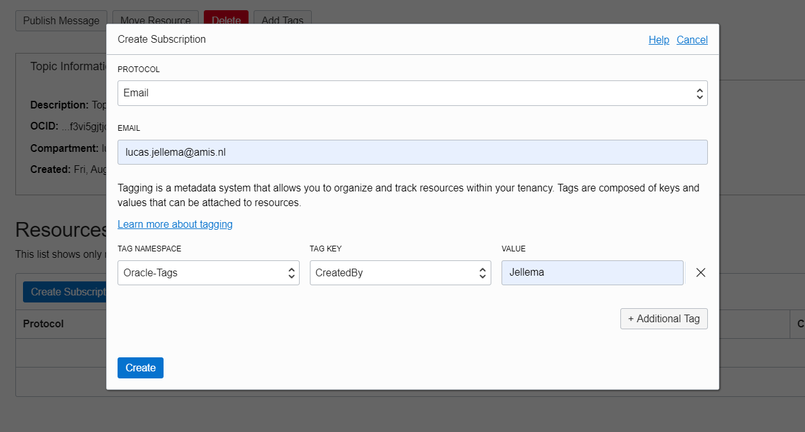
Send email upon Notification

Slide 57
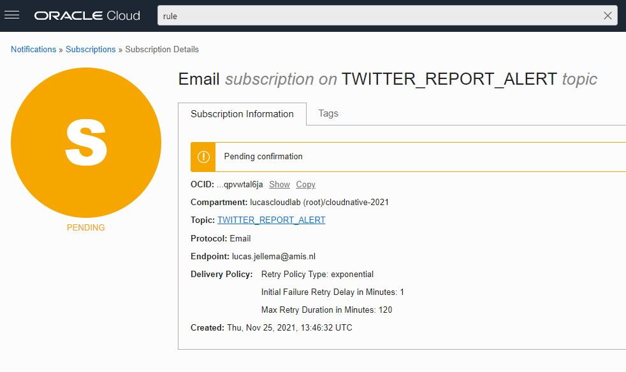
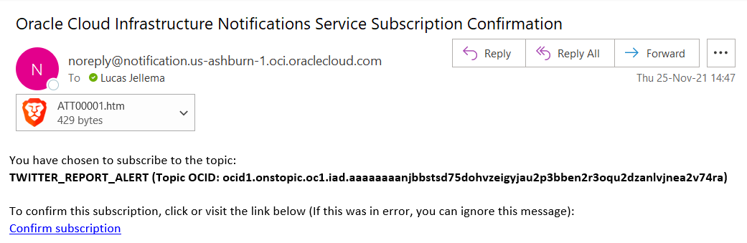
Email Subscription is Pending until confirmed

Slide 58
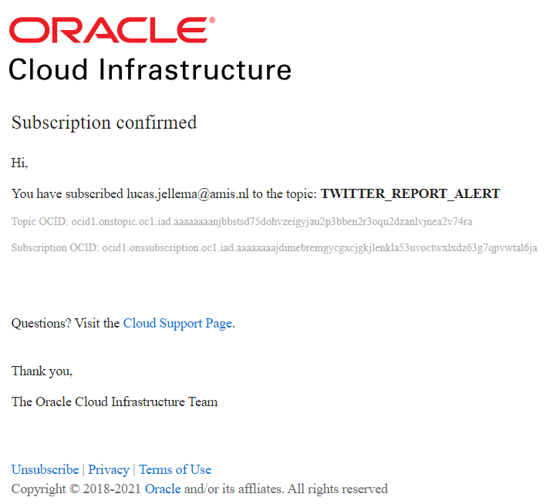
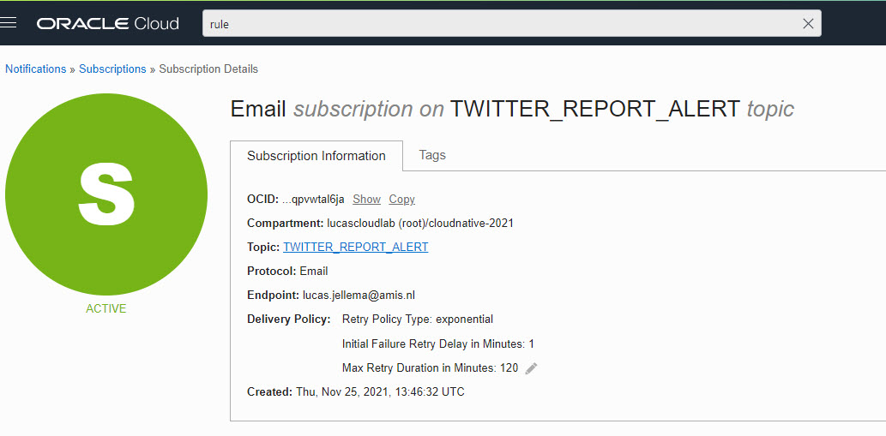
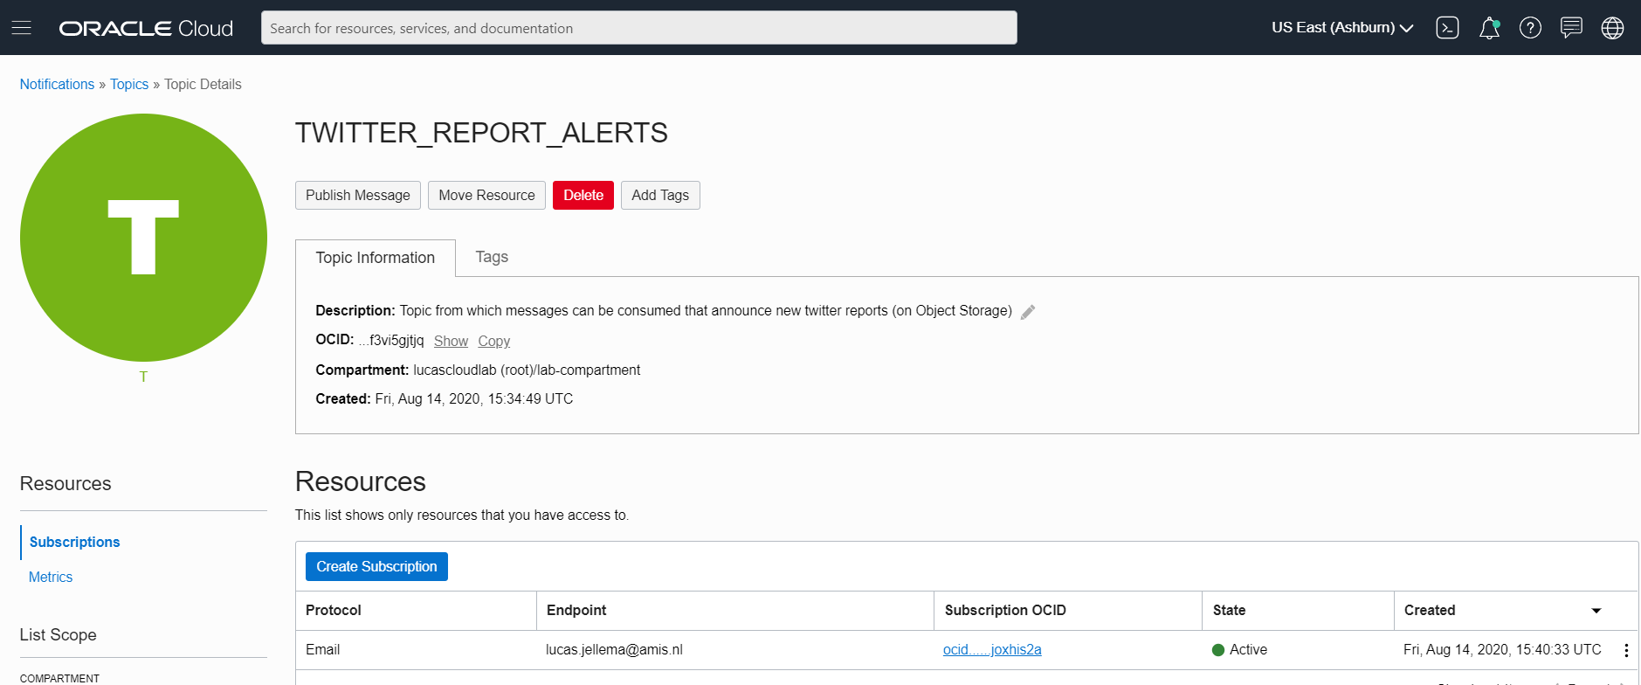
When confirmed, the subscription is active

Slide 59

When the Tweet Summarizer is invoked…
Object Storage
API Gateway
Events
Notifications
Function
Vault
Oracle Groundbreakers Tour 2020 LATAM | Oracle Cloud Native Application Development

Slide 60
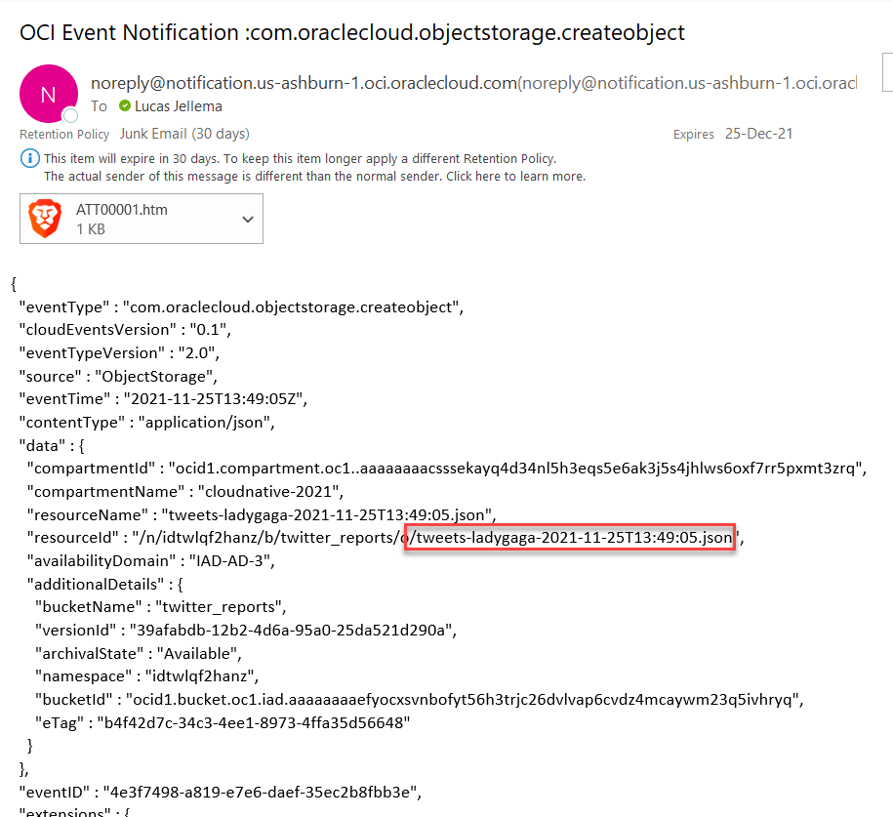
… the email informs of the new file
Object Storage
API Gateway
Events
Notifications
Function
Vault

Slide 61
Trigger Function
NoSQL Database
Function
Object Storage
Healthcheck
Trigger function with event
API Gateway
Events
Notifications
Function
Vault
#hashtagofinterest

Slide 62
Function: Create NoSQL Records for all Tweets
Retrieve Tweet Report
Create Tweet Records in NoSQL
NoSQL Database
Function
Object Storage
Healthcheck
API Gateway
Events
Notifications
Function
Vault
#hashtagofinterest

Slide 63
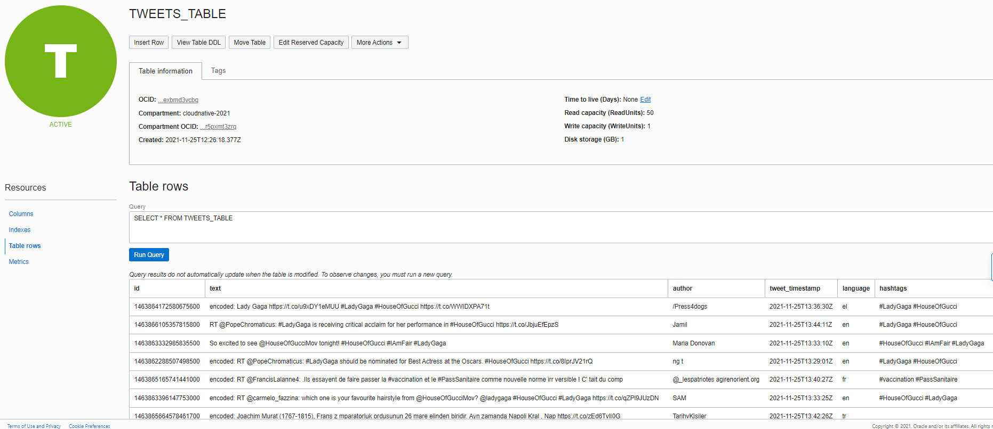
Function: Create NoSQL Records for all Tweets
Retrieve Tweet Report
Create Tweet Records in NoSQL
NoSQL Database
Function
Object Storage
Healthcheck
API Gateway
Events
Notifications
Function
Vault
#hashtagofinterest

Slide 64
Publish Tweet records to Stream
NoSQL Database
Function
Object Storage
Healthcheck
API Gateway
Events
Streaming
Notifications
Publish each Tweet to Stream
Function
Vault
#hashtagofinterest

Slide 65
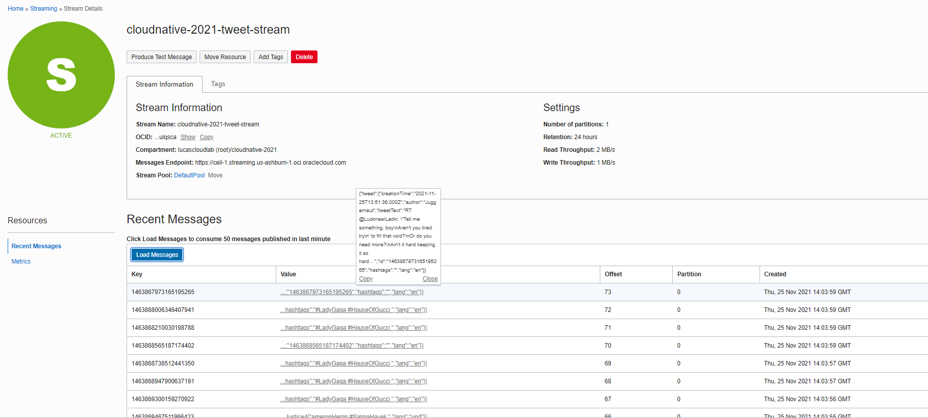
Publish Tweet records to Stream
NoSQL Database
Function
Object Storage
Healthcheck
API Gateway
Events
Streaming
Notifications
Publish each Tweet to Stream
Function
Vault
#hashtagofinterest

Slide 66
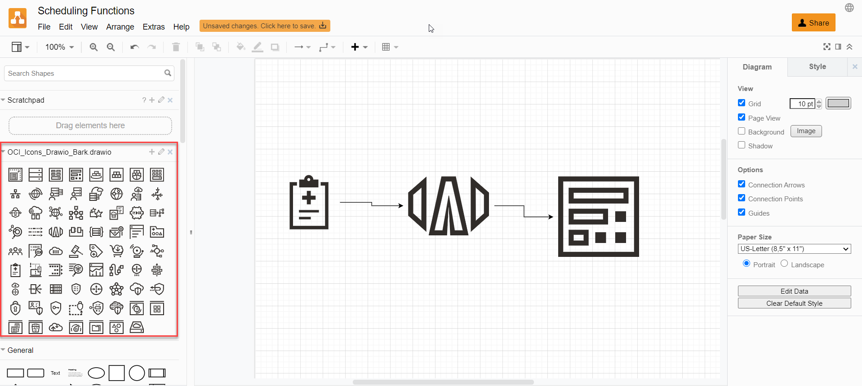
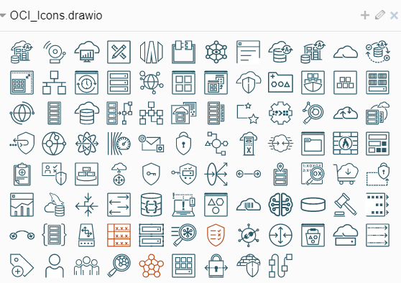
Drawing OCI Solution Designs on draw.io
Download draw.io graphics from https://docs.cloud.oracle.com/en-us/iaas/Content/General/Reference/graphicsfordiagrams.htm… , unzip and upload as library to draw.io
Notes:
https://docs.oracle.com/en-us/iaas/Content/General/Reference/graphicsfordiagrams.htm

Slide 67



Summary
Cloud Native: Pay per use/TCO
NoSQL Database
DDoS Protection
Function
Object Storage
WAF
API Gateway
Events
Streaming
Notifications
Function
Cloud Guard
Healthcheck
Identity & Access
Management
Email Delivery
Logging
Container Registry
Vault
DevOps
Auditing
Compartments
Monitoring
#hashtagofinterest

Slide 68





Pay per use
NoSQL Database
Function
Object Storage
API Gateway
Events
Streaming
Function
Notifications
Healthcheck
Cloud Guard
Identity & Access
Management
Email Delivery
Vault
Compartments
Logging
Container Registry
Monitoring
Auditing
First X
Free
Always Free
Tier
Low unit
price
Elastic Pricing

Slide 69
Summary
Cloud Native: Pay per use/TCO
NoSQL Database
DDoS Protection
Function
Object Storage
WAF
API Gateway
Events
Streaming
Notifications
Function
Cloud Guard
Healthcheck
Identity & Access
Management
Email Delivery
Container Registry
Vault
DevOps
Auditing
Compartments
Monitoring
#hashtagofinterest

Slide 70
Summary
Cloud Native: Platform Services
Managed => Serverless
Quick Provision & Decommission
Distributed
Automated
Pay per use/TCO
Vendor takes runtime responsibility
Enterprise grade platform for all Security & Availability
Scale
Ops facilities (monitor, log, audit, events, failover)
Rapid Innovation (new services, new features, new pricing)
NoSQL Database
DDoS Protection
Function
Object Storage
WAF
API Gateway
Events
Streaming
Notifications
Function
Cloud Guard
Healthcheck
Identity & Access
Management
Email Delivery
Container Registry
Vault
DevOps
Auditing
Compartments
Monitoring
#groundbreakerstour

Slide 71
Thank you for your attention I hope this was useful
Sources and slides: bit.ly/cloud-native-ogb-apacouc2021
lucas.jellema@amis.nl | technology.amis.nl | @lucasjellema | lucas-jellema

